Slide 1

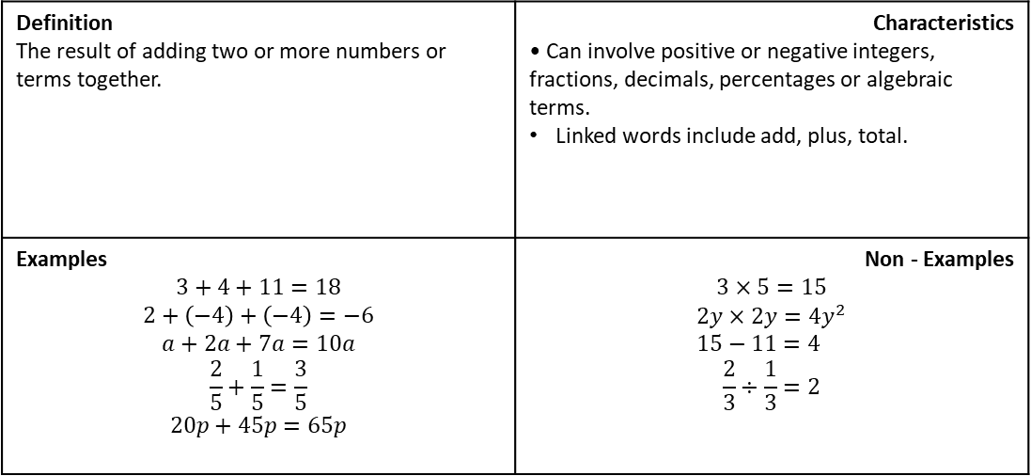
Subtopic 4 – The Four Operations
LEARNING OUTCOME: To use the four rules of arithmetic with integers and decimals.
Objectives:
Keywords:
Sum
Difference
Division
Multiplication
To add and subtract positive numbers.
To multiply and divide positive numbers.
To solve problems using different rules of arithmetic.
Definition The result of adding two or more numbers or terms together. | Characteristics • Can involve positive or negative integers, fractions, decimals, percentages or algebraic terms. Linked words include add, plus, total.
Examples $$3+4+11=18$$ $$2+\left(−4\right)+\left(−4\right)=−6 \\ a+2a+7a=10a \\ \frac{2}{5}+\frac{1}{5}=\frac{3}{5} \\ 20p+45p=65p$$ | Non - Examples $$3×5=15$$ $$2y×2y=4y^{2} \\ 15−11=4$$ $$\frac{2}{3}÷\frac{1}{3}=2$$
Addition/Sum
Addition
Example 1- I do…
Example 2 - We do…
Example 3 - You do…
Steps | Calculate 15 + 3 | Calculate 17 + 2 | Calculate 11 + 8
Line up both numbers in the correct columns 2. Add each column starting with the lowest column
 | T | O
 | 1 | 5
+ |  | 3
 | T | O
+
 | T | O
+
Notes:
OBJECTIVES

Slide 2
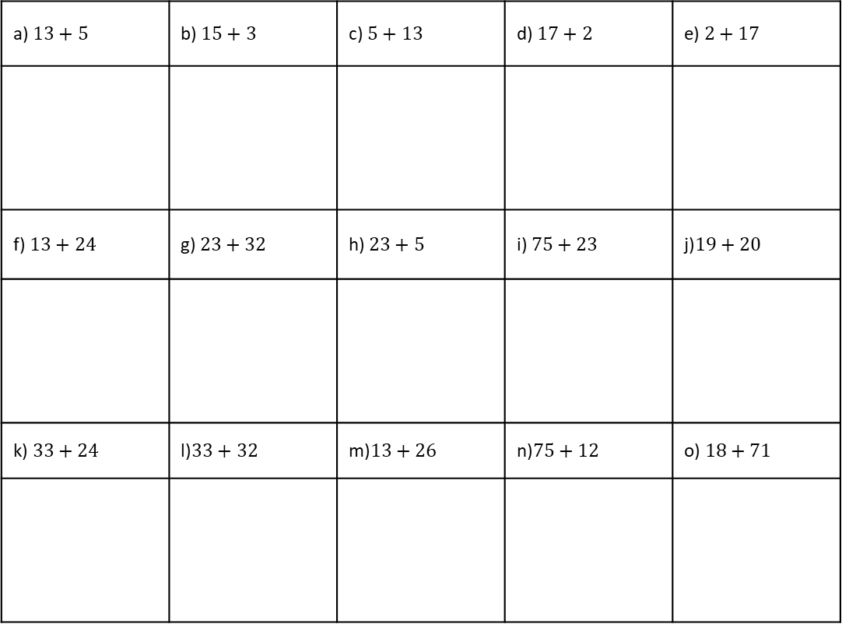
Setting out and adding one- and two-digit integers using column method
Example 4 - I do…
Example 5 - We do…
Example 6 - You do…
Steps | Calculate 5 + 37 | Calculate 18 + 75 | Calculate 54 + 17
1. Line up both numbers in the correct columns
2. Add each column starting with the lowest column
Independent Practice
1. Add the following integers using column method
a) $13+5$ | b) $15+3$ | c) $5+13$ | d) $17+2$ | e) $2+17$
f) $13+24$ | g) $23+32$ | h) $23+5$ | i) $75+23$ | j)$19+20$
k) $33+24$ | l)$33+32$ | m)$13+26$ | n)$75+12$ | o) $18+71$
p) Sally is calculating 438 + 100. Can you explain the mistake she has made?
4 3 8
+ 1 0 0
4 4 8 0

Slide 3
Setting out and adding three-digit integers using column method involving exchanges
Example 7 - I do…
Example 8 - We do…
Example 9 - You do…
Steps
1. Line up numbers in the correct columns
2. Add each column starting with the lowest
3. Write how many groups of ten are exchanged
4. Add this to your next column and repeat
Calculate 425 + 878
Calculate 248 + 67
Calculate 455 + 775
Independent Practice
1. Add the following integers using column method
Independent Practice
2. Add the following integers using column method
a) 352 + 451 =
b) 255 + 182 =
c) 458 + 379 =
d) 356 + 45 =
e) 259 + 67 =
f) 456 + 79 =
g) Find the sum of 796 and 455
h) Find the sum of 89 and 678
i) Find the sum of 49 and 887

Slide 4

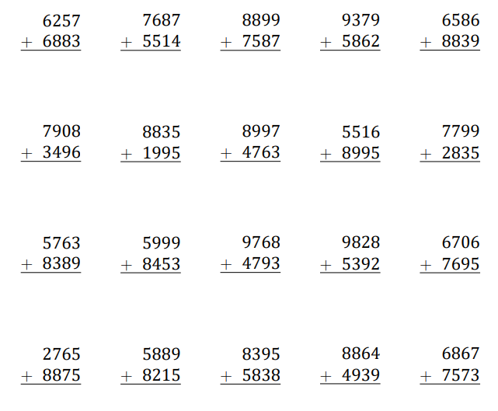
Adding four- digit integers using column method involving exchanges
Example 10 I do…
Example 11 - We do…
Example 12 - You do…
Steps | Calculate 9851 + 3279 | Calculate 5852 + 5378 | Calculate 8963 + 3267
1. Add each column starting with the lowest column
2. Write how many groups of ten are exchanged
3. Add this to your next column
+
9 8 5 1
3 2 7 9
+
5 8 5 2
5 3 7 8
+
8 9 6 3
3 2 6 7
Independent Practice
3. Add the following integers using column method
a) b) c) d) e)
f) g) h) i) j)
k) l) m) n) o)
p) q) r) s) t)

Slide 5
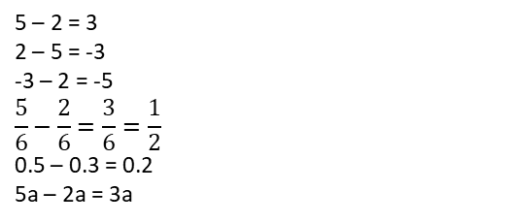
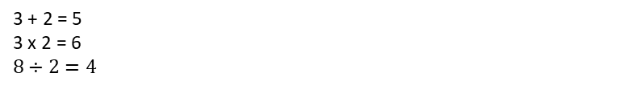
Subtraction
Definition
Characteristics
• Can involve positive or negative integers, fractions, decimals, percentages or algebraic terms.
Linked words include minus, difference, less than, reduce.
A mathematical operation in which the difference between two numbers or quantities is calculated.
Examples
SUBTRACT
Non - Examples
5 – 2 = 3
2 – 5 = -3
-3 – 2 = -5
$$\frac{5}{6}−\frac{2}{6}=\frac{3}{6}=\frac{1}{2}$$
0.5 – 0.3 = 0.2
5a – 2a = 3a
3 + 2 = 5
3 x 2 = 6
$$8÷2=4$$
.
 | For the following questions, use this number line to help you place the numbers in ascending order
Steps | 83 – 52 | 96 – 24 | 45 – 32
1) Write the numbers in columns, ensuring that they are lined up correctly.
2) Starting from the ones column, complete subtraction.
Example 13 - I do…
Example 14 – We do…
Example 15 – You do…
Notes:
OBJECTIVES

Slide 6
Example 16 - I do…
Example 17 – We do…
Example 18 – You do…
Steps | 5183 – 52 | 4782 – 41 | 3494 - 23
1) Write the numbers in columns, ensuring that they are lined up correctly.
2) Starting from the ones column, complete subtraction.
Independent Practice
9. For the following questions, use the column method to work out the subtraction problems:
a) 79 – 22 | b) 89 – 22 | c) 89 – 11
d) 89 – 17 | e) 19 – 17 | f) 99 – 17
g) 197 – 12 | h) 297 – 12 | i) 297 – 61

Slide 7
j) 298 – 91 | k) 298 – 71 | l) 497 – 71
m) 785 – 512 | n) 859 – 132 | o) 557 – 319
p) 946 – 230 | q) 4854 – 1132 | r) 4871 – 1540
s) 5792 – 4431 | t) 4781 – 1650 | u) 48832 – 14501

Slide 8
Example 19 - I do…
Example 20 – We do…
Example 21 – You do…
Steps | 94 - 36 | 62 - 28 | 53 - 39
1) Write the numbers in columns, ensuring that they are lined up correctly.
2) Starting from the ones column, complete subtraction.
3) Exchange where appropriate.
Example 22 - I do…
Example 23 – We do…
Example 24 – You do…
Steps | 3417 - 58 | 6423 - 49 | 7342 - 95
1) Write the numbers in columns, ensuring that they are lined up correctly.
2) Starting from the ones column, complete subtraction.
3) Exchange where appropriate.

Slide 9
Independent Practice
10. For the following questions, use the column method to work out the subtraction problems:
a) 67 – 24 | b) 78 – 29 | c) 92 - 38
d) 105 – 83 | e) 123 - 89 | f) 150 - 62
g) 156 - 74 | h) 187 - 105 | i) 267 – 194
j) 312 – 187 | k) 398 – 256 | l) 1452 - 898

Slide 10
Example 25 - I do…
Example 26 – We do…
Example 27 – You do…
Steps | John buys a chocolate bar for £1.55 and a lemonade for £0.98. How much more expensive is the chocolate bar than the lemonade? | At a football match, there are 8509 united fans and 6883 city fans. How many more united fans are there than city fans? | Kelly has 25 marbles and Hannah has 144 marbles. How many more marble does Hannah have than Kelly?
1) Write the numbers in columns, ensuring that they are lined up correctly.
2) Starting from the ones column, complete subtraction.
Independent Practice
11. Sarah buys an apple for 41p and a banana for 27p. How much more expensive is an apple than a banana?
12. Kelly has 76 marbles and Hannah has 102 marbles. How many more marble does Hannah have than Kelly?
13. At a football match there are 2942 Rovers fans and 9381 City fans. How many more fans did City have?
14. Theo wants to buy a laptop that costs £425. Theo has saved £267 so far. How much more money does Theo need to save?

Slide 11
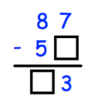
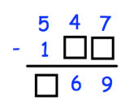
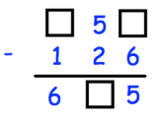
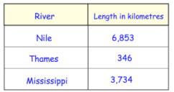
15. For the following questions, fill in the missing numbers.
a) | b) |  | c)
16. The table shows the lengths of three rivers. |  | How much longer is the Nile than the combined lengths of the other two rivers?
17. Work out the difference between 234,789 and 502,113

Slide 12
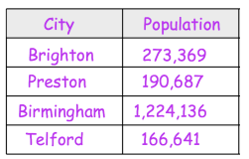


18. This table shows the number of people living in various cities in England. | How many more people live in Birmingham than Preston?
19. For the following questions, fill in the missing numbers.
a) | b)
20. Write down the number that is ten thousand less than two million.

Slide 13

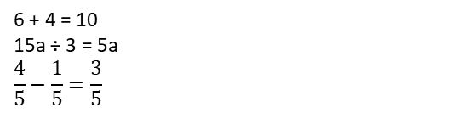
Multiplication
Definition
Characteristics
The result of multiplying two or more numbers or terms together.
3 x 5 = 15
Products are not always larger than their factors
Product
Factors
Examples
Multiplication/Product
Non - Examples
2 x 3 = 6
9 x -3 = -27
½ x ¾ = $\frac{3}{8}$
2a x 2a = 4a²
6 + 4 = 10
15a ÷ 3 = 5a
$$\frac{4}{5}−\frac{1}{5}=\frac{3}{5}$$
Example 28 - I do…
Example 29 – We do…
Example 30– You do…
Calculate: 34 x 7 | Calculate: 43 x 7 | Calculate: 36 x 7
Independent Practice
21. Without a calculator, calculate the following:
a) 32 x 3 | b) 23 x 3 | c) 46 x 7
d) 46 x 9 | e) 9 x 46 | f) 98 x 7
Notes:
Example 7 – division sign

Slide 14
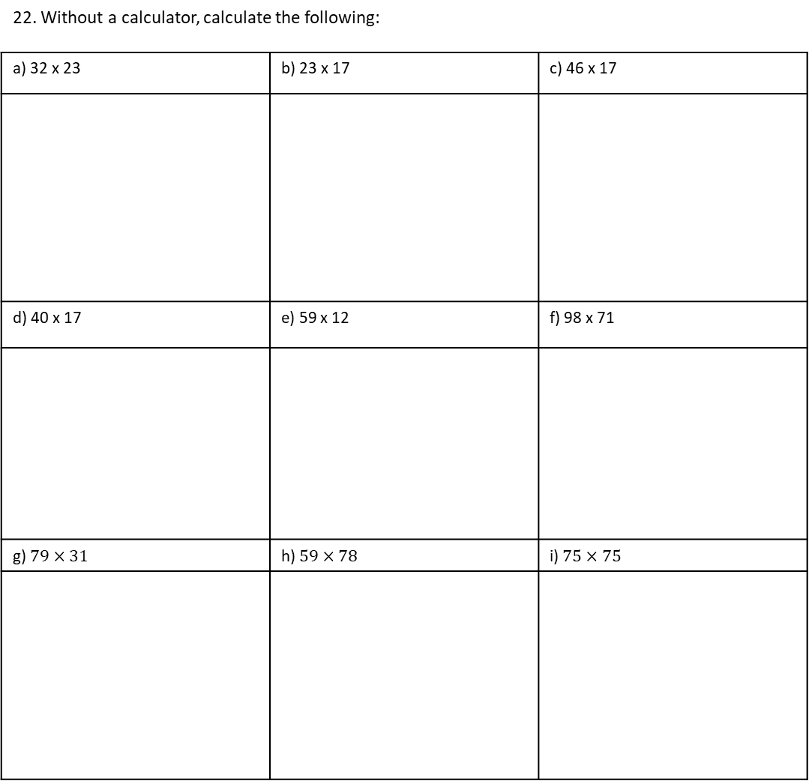
14 x 27 | 23 x 35 | 18 x 37
Example 31 - I do…
Example 32 – We do…
Example 33 – You do…
Independent Practice
22. Without a calculator, calculate the following:
a) 32 x 23 | b) 23 x 17 | c) 46 x 17
d) 40 x 17 | e) 59 x 12 | f) 98 x 71
g) $79×31$ | h) $59×78$ | i) $75×75$

Slide 15


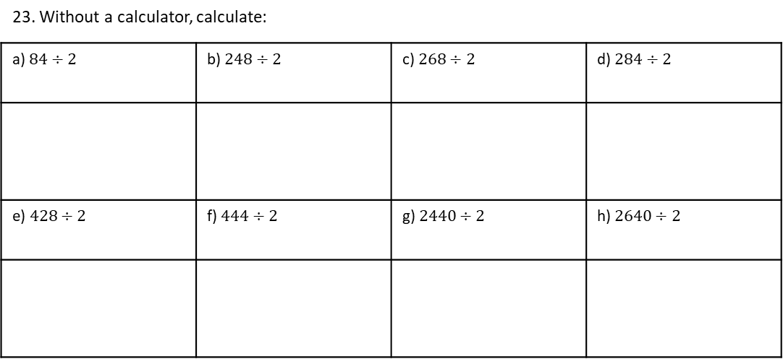
Short Division
Definition
Characteristics
A number by which another number is divided
425 ÷ 5 = 85
$$\frac{425}{5}=85$$
Divisor
Examples
Divisor
Non - Examples
6 ÷ 3 = 2
3 is the divisor
Cannot be the numerator of a fraction
Example 34 - I do…
Example 35 – We do…
Example 36 – You do…
Steps | Calculate: $242÷2$ | Calculate: $420÷2$ | Calculate: $224÷2$
1) Set out the numbers in the correct layout.
2) Complete the division, carrying where appropriate.
Independent Practice
23. Without a calculator, calculate:
a) $84÷2$ | b) $248÷2$ | c) $268÷2$ | d) $284÷2$
e) $428÷2$ | f) $444÷2$ | g) $2440÷2$ | h) $2640÷2$
Notes:
Example 7 – division sign

Slide 16
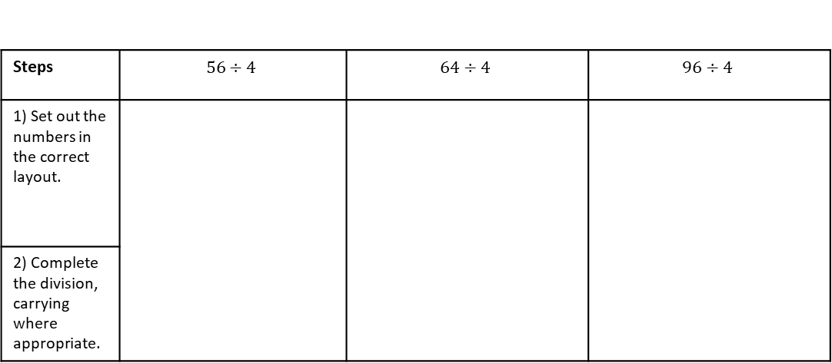

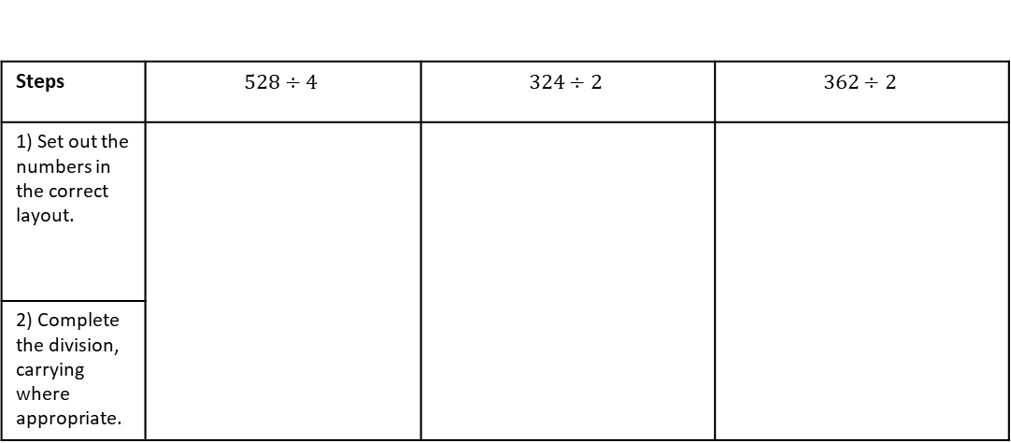
Steps | $$56÷4$$ | $$64÷4$$ | $$96÷4$$
1) Set out the numbers in the correct layout.
2) Complete the division, carrying where appropriate.
Example 37 - I do…
Example 38 – We do…
Example 39 – You do…
Steps | $$528÷4$$ | $$324÷2$$ | $$362÷2$$
1) Set out the numbers in the correct layout.
2) Complete the division, carrying where appropriate.
Example 40 - I do…
Example 41 – We do…
Example 42 – You do…
Steps | $$3232÷2$$ | $$3112÷4$$ | $$3332÷4$$
1) Set out the numbers in the correct layout.
2) Complete the division, carrying where appropriate.
Example 43 - I do…
Example 44 - We do…
Example 45 – You do…

Slide 17
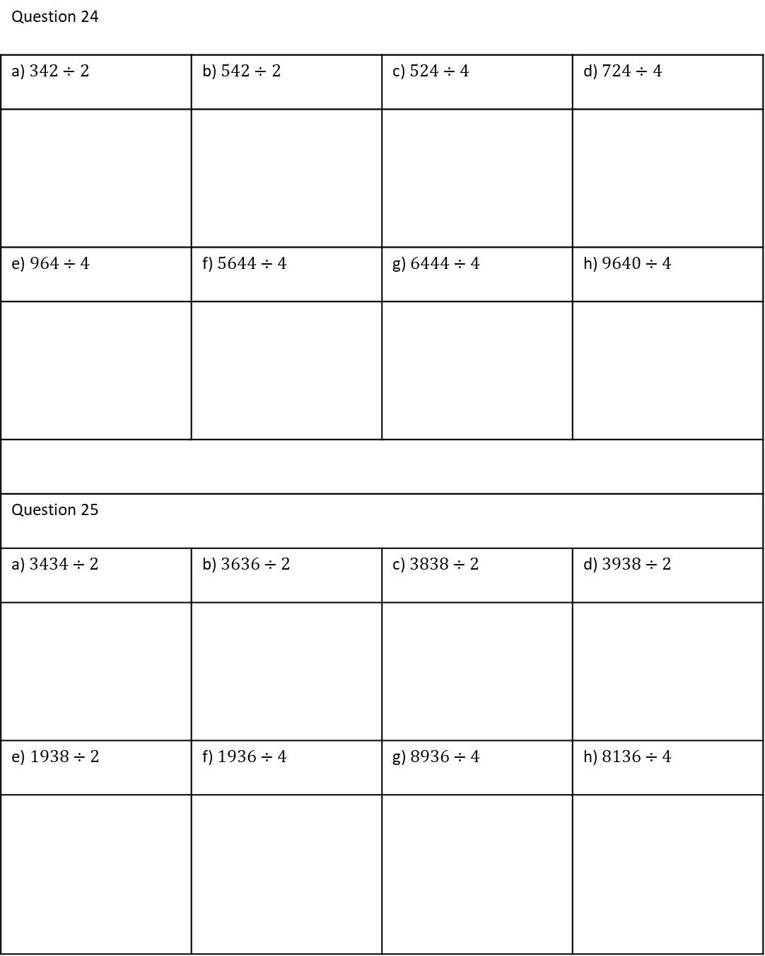
Independent Practice
Question 24
a) $342÷2$ | b) $542÷2$ | c) $524÷4$ | d) $724÷4$
e) $964÷4$ | f) $5644÷4$ | g) $6444÷4$ | h) $9640÷4$
Question 25
a) $3434÷2$ | b) $3636÷2$ | c) $3838÷2$ | d) $3938÷2$
e) $1938÷2$ | f) $1936÷4$ | g) $8936÷4$ | h) $8136÷4$

Slide 18
26. Answer these questions by completing a suitable multiplication.
(a) How many days are there in 17 weeks?
(b) How many hours are there in four days?
(c) Eggs are packed in boxes of six. How many eggs altogether are there in 24 boxes?
(d) Joe bought five boxes of matches. Each box contained 42 matches. How many matches did Joe buy altogether?
27. Answer these questions by completing a suitable division.
(a) How many weeks are there in 91 days?
(b) How long will it take me to save £111, if I save £3 a week?
(c) A rope, 21.5 m long, is cut into five equal pieces. How long is each piece?
28. There are seven columns on one page of a newspaper. In each column there are 172 lines, and in each line there are 50 letters. The newspaper has the equivalent of 20 pages of print, excluding photographs and adverts. Are there more than a million letters in the paper?
29. A tank of water was emptied into casks. Each cask held 81 litres. 71 casks were filled and there were 68 litres left over. How much water was there in the tank to start with?
30. Joy is doing a sponsored walk. She managed to get 18 people to sponsor her, each for 35p per kilometre. She walked a total of 48 km. Did Joy reach her fundraising target of £400?
Notes:
MORE WORDED QUESTION
LONG DIVISON w/example

Slide 19
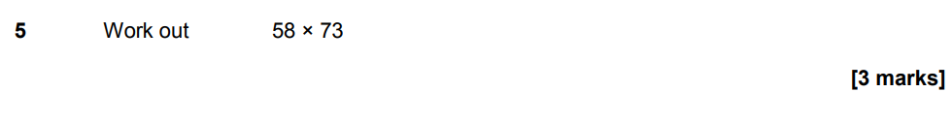
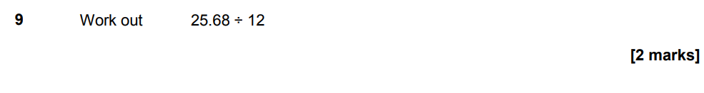
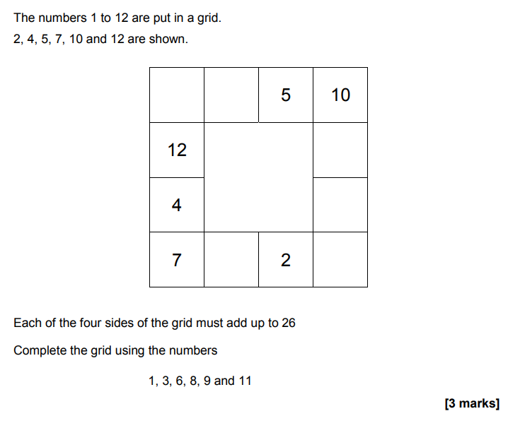
GCSE PAST PAPER QUESTIONS – Non Calculator paper
Calculator paper
Notes:
Exam questions

Slide 20
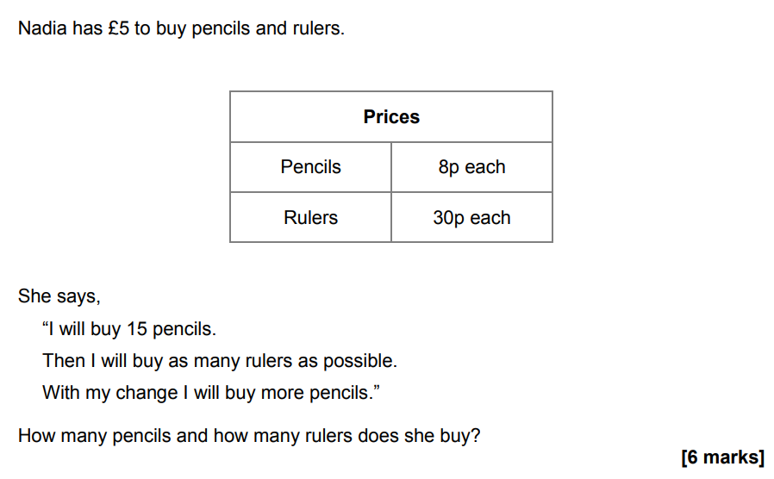
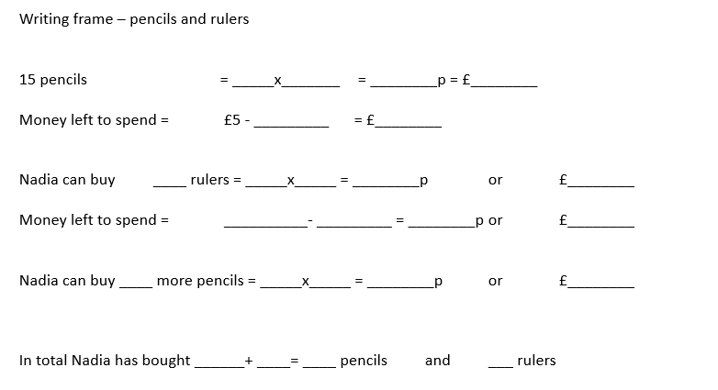
GCSE PAST PAPER QUESTIONS – context (NON-CALCULATOR)
Notes:
Exam questions

Slide 21
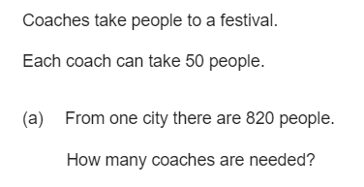
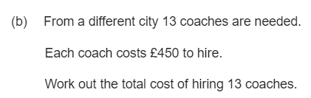

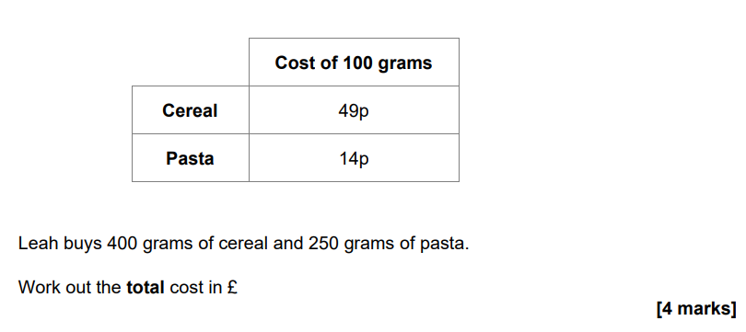
GCSE PAST PAPER QUESTIONS – context (NON-CALCULATOR)
Notes:
Exam questions

Slide 22
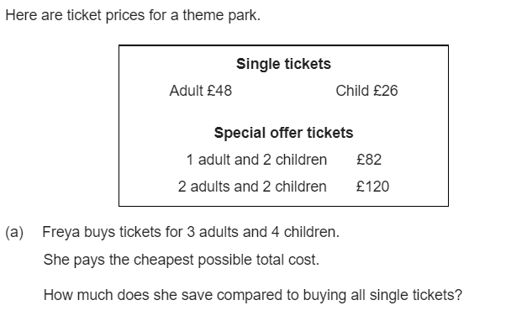
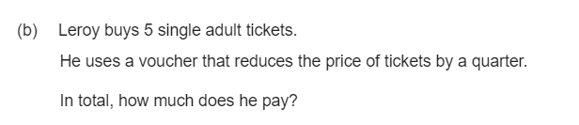

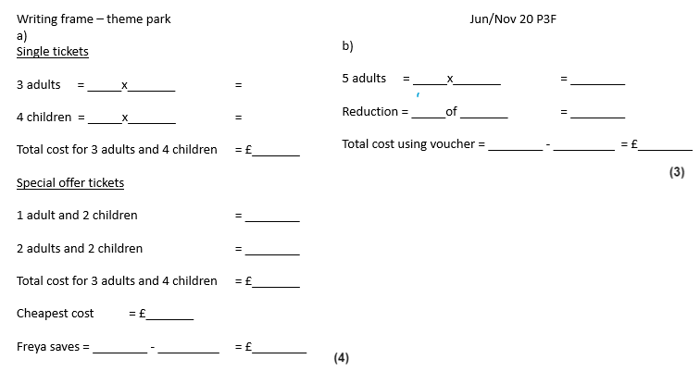
GCSE PAST PAPER QUESTIONS – context (Calculator allowed)
Notes:
Exam questions

Slide 23
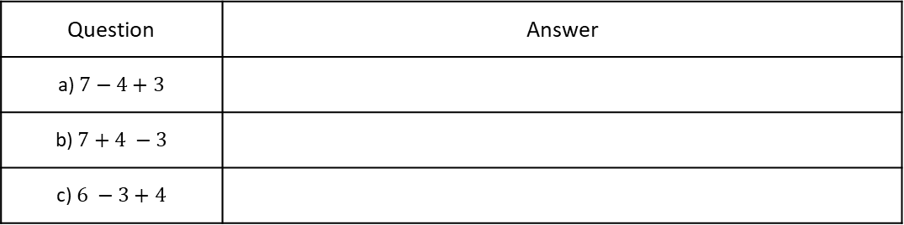
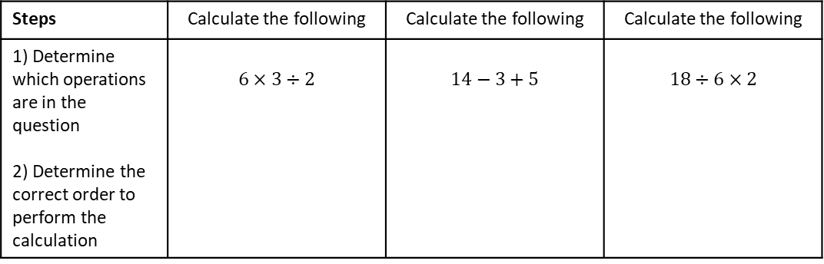



Subtopic 5– Order of Operations
LEARNING OUTCOME: To understand and apply correct order of operations
Keywords:
Operation
Index
Power
Root
Objectives:
To correctly apply order of operations with the four operations.
To correctly apply order of operations including indices and brackets.
To insert brackets into calculations to make them correct.
Introduction – In this unit so far, you’ve built strong foundations using the four operations. Now, you’ll apply that knowledge to solve problems using the correct order of operations. The order of operations follows a specific sequence: brackets first, then multiplication and division (from left to right), followed by addition and subtraction (from left to right). Understanding and applying this order is essential for solving multi-step problems accurately.
Definition
-
$$×$$
Characteristics
Operations in mathematics refer to the basic mathematical actions or processes used to perform calculations and solve problems.
+
$$√$$
$$÷$$
Operation
Non - Examples
Examples
In the expression 3 + 4, the operation is addition, which combines 3 and 4 to give a sum of 7.
In the expression 12 ÷ 3, the operation is division, indicating that 12 is shared into 3 equal parts, resulting in 4
23
4.76
Order of operations with $×$ / $÷$ only or $+$ / - only
When calculations have only addition and subtraction OR only multiplication and division, work from left to right.
Example 1 - I do…
Example 2 – We do…
Example 3 – You do…
Steps | Calculate the following | Calculate the following | Calculate the following
1) Determine which operations are in the question 2) Determine the correct order to perform the calculation | $$6×3÷2$$ | $$14−3+5$$ | $$18÷6×2$$
Independent Practice
1. Work out the answers to the following:
Question | Answer
a) $7−4+3$
b) $7+4 −3$
c) $6 −3+4$

Slide 24
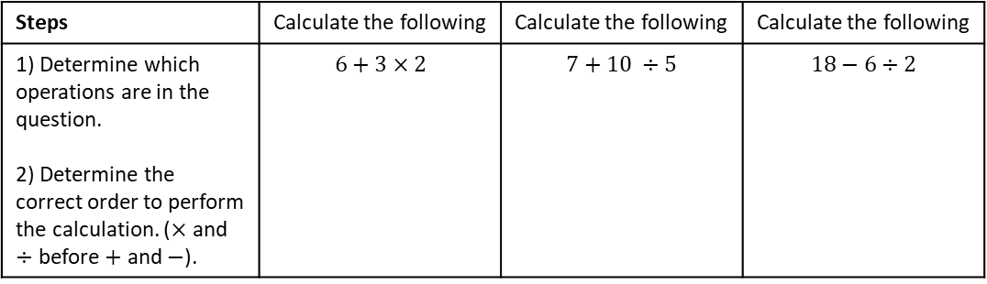
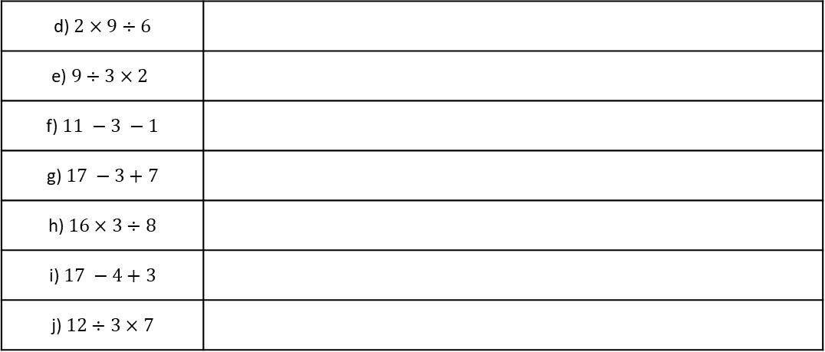
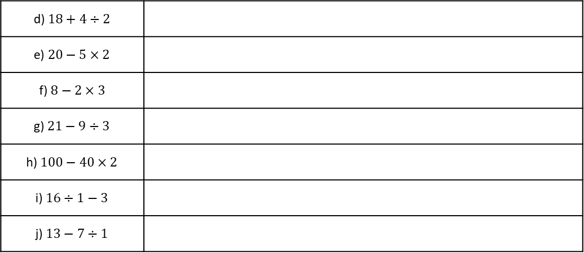

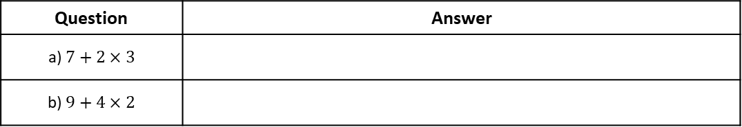
d) $2×9÷6$
e) $9÷3×2$
f) $11 −3 −1$
g) $17 −3+7$
h) $16×3÷8$
i) $17 −4+3$
j) $12÷3×7$
Order of operations with $×/÷/+/−$
Example 4 - I do…
Example 5 – We do…
Example 6 – You do…
Steps | Calculate the following | Calculate the following | Calculate the following
1) Determine which operations are in the question. 2) Determine the correct order to perform the calculation. ($×$ and $÷$ before $+$ and $−$). | $$6+3×2$$ | $$7+10 ÷5$$ | $$18−6÷2$$
Independent Practice
2. Work out the answers to the following:
Question | Answer
a) $7+2×3$
b) $9+4×2$
d) $18+4÷2$
e) $20−5×2$
f) $8−2×3$
g) $21−9÷3$
h) $100−40×2$
i) $16÷1−3$
j) $13−7÷1$

Slide 25
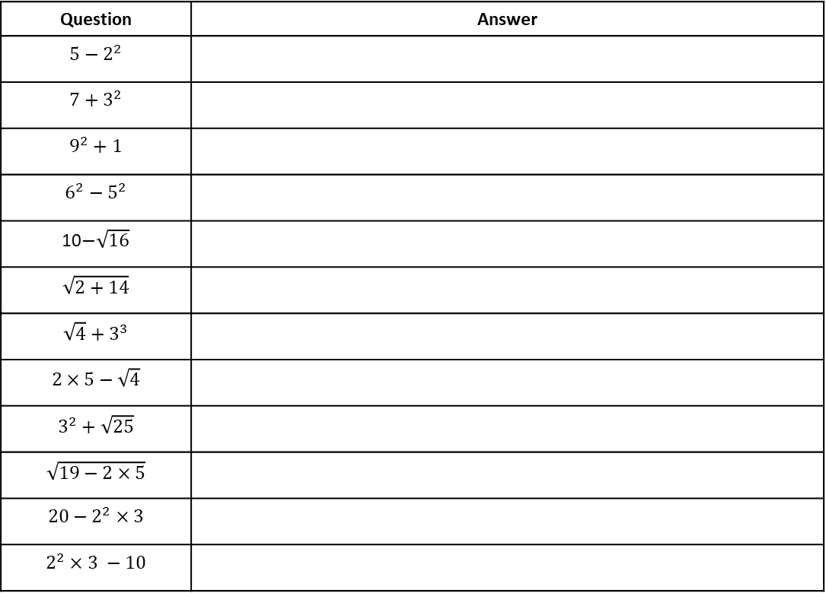
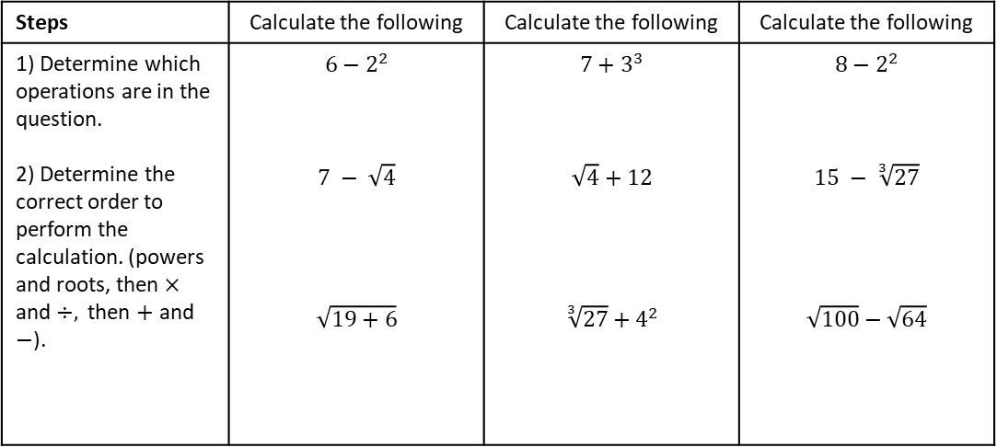
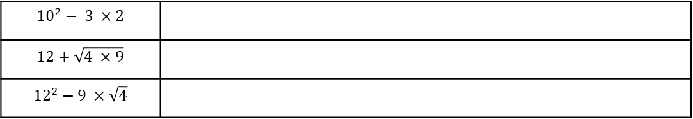
Order of operations involving powers and roots
Example 7 - I do…
Example 8 – We do…
Example 9 – You do…
Steps | Calculate the following | Calculate the following | Calculate the following
1) Determine which operations are in the question. 2) Determine the correct order to perform the calculation. (powers and roots, then $×$ and $÷,$ then $+$ and $−$). | $$6−2^{2}$$ $$7 − \sqrt{4}$$ $$\sqrt{19+6}$$ | $$7+3^{3}$$ $$\sqrt{4}+12$$ $$\sqrt[3]{27}+4^{2}$$ | $$8−2^{2}$$ $$15 − \sqrt[3]{27}$$ $$\sqrt{100}−\sqrt{64}$$
Independent Practice
3. Work out the answers to the following:
Question | Answer
$$5−2^{2}$$
$$7+3^{2}$$
$$9^{2}+1$$
$$6^{2}−5^{2}$$
10$−\sqrt{16}$
$$\sqrt{2+14}$$
$${\sqrt{4}+3}^{3}$$
$$2×5−\sqrt{4}$$
$$3^{2}+\sqrt{25}$$
$$\sqrt{19−2×5}$$
$$20−2^{2}×3$$
$$2^{2}×3 −10$$
$${10}^{2}− 3 ×2$$
$$12+\sqrt{4 ×9}$$
$${12}^{2}−9 ×\sqrt{4}$$

Slide 26
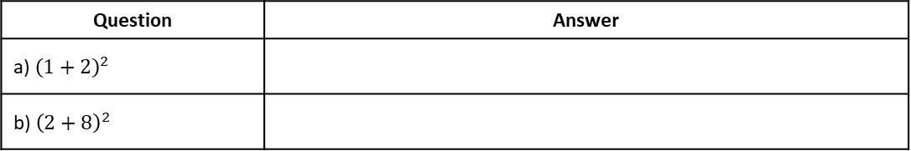
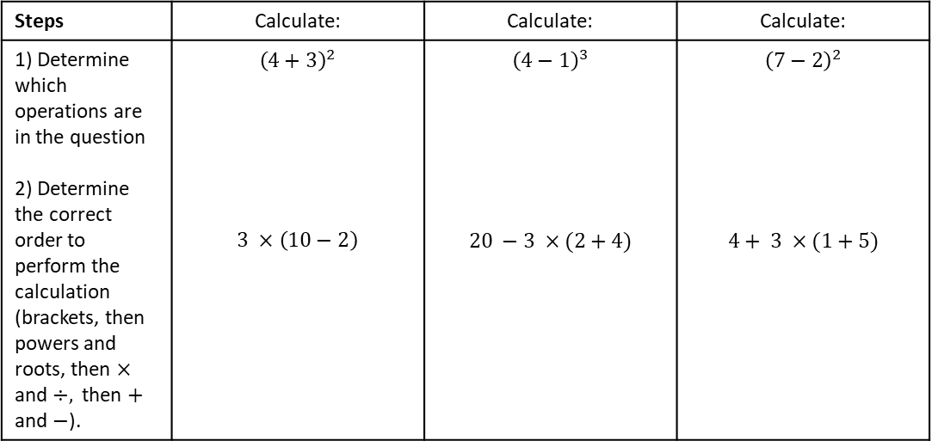
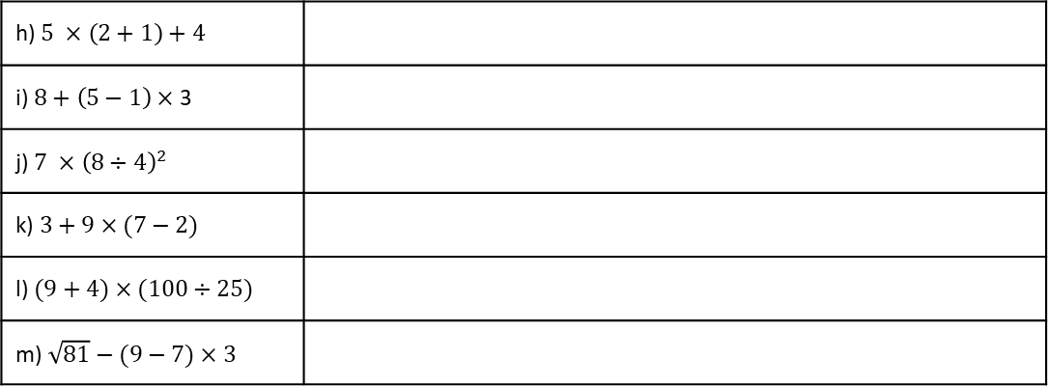
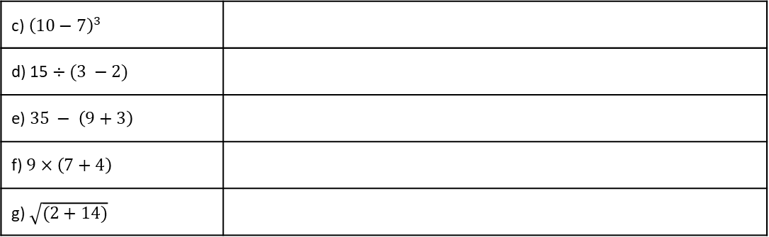
Order of operations involving brackets
Example 10 - I do…
Example 11 – We do…
Example 12 – You do…
Steps | Calculate: | Calculate: | Calculate:
1) Determine which operations are in the question 2) Determine the correct order to perform the calculation (brackets, then powers and roots, then $×$ and $÷,$ then $+$ and $−$). | $${\left(4+3\right)}^{2}$$ $$3 ×\left(10−2\right)$$ | $${\left(4−1\right)}^{3}$$ $$20 −3 ×(2+4)$$ | $${\left(7−2\right)}^{2}$$ $$4+ 3 ×(1+5)$$
Independent Practice
4. Work out the answers to the following:
Question | Answer
a) ${\left(1+2\right)}^{2}$
b) ${\left(2+8\right)}^{2}$
c) ${\left(10−7\right)}^{3}$
d) 15 $÷(3 −2)$
e) $35 − \left(9+3\right)$
f) $9×\left(7+4\right)$
g) $\sqrt{(2+14)}$
h) $5 ×\left(2+1\right)+4$
i) $8+\left(5−1\right)×$ 3
j) $7 ×{\left(8÷4\right)}^{2}$
k) $3+9×(7−2)$
l) $(9+4)×(100÷25)$
m) $\sqrt{81}−(9−7)×3$

Slide 27
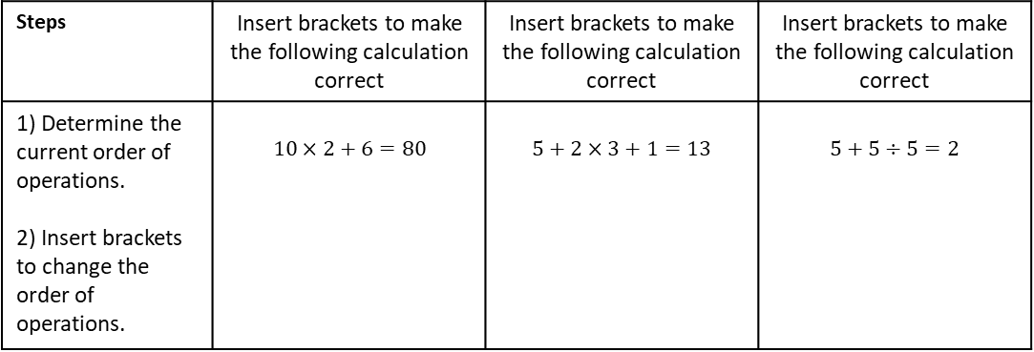
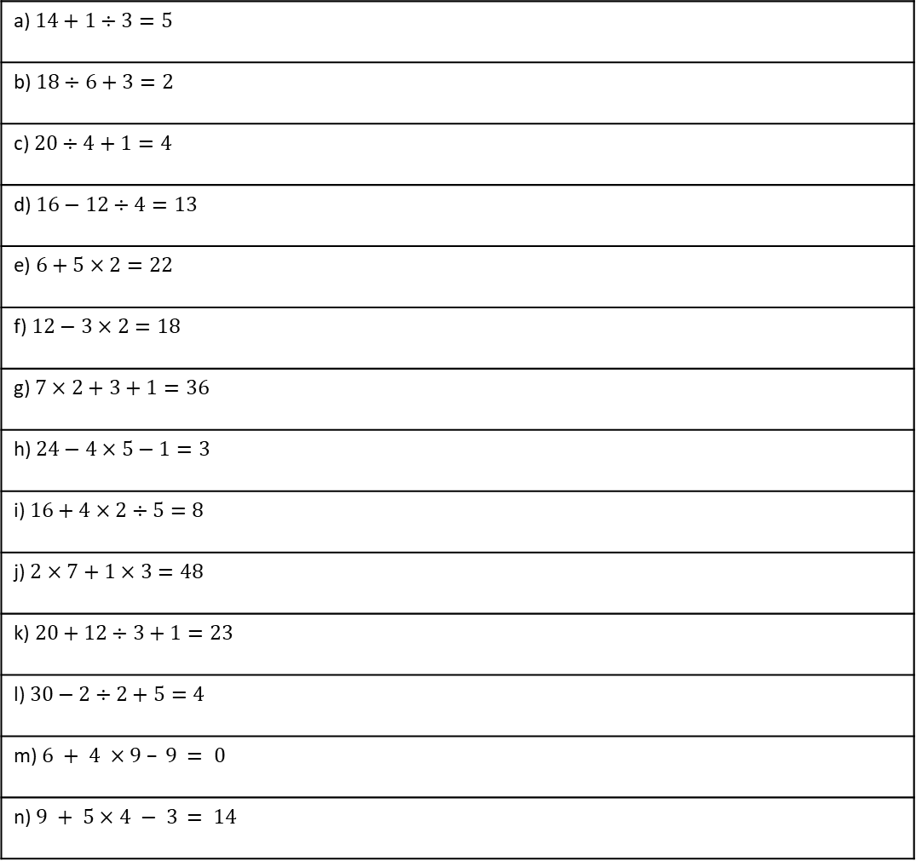
Inserting Brackets
Example 13 - I do…
Example 14 – We do…
Example 15 – You do…
Steps | Insert brackets to make the following calculation correct | Insert brackets to make the following calculation correct | Insert brackets to make the following calculation correct
1) Determine the current order of operations. 2) Insert brackets to change the order of operations. | $$10×2+6=80$$ | $$5+2×3+1=13$$ | $$5+5÷5=2$$
Independent Practice
5. Insert brackets to make the following calculations correct:
a) $14+1÷3=5$
b) $18÷6+3=2$
c) $20÷4+1=4$
d) $16−12÷4=13$
e) $6+5×2=22$
f) $12−3×2=18$
g) $7×2+3+1=36$
h) $24−4×5−1=3$
i) $16+4×2÷5=8$
j) $2×7+1×3=48$
k) $20+12÷3+1=23$
l) $30−2÷2+5=4$
m) $6 + 4$ $×9 – 9$ $= 0$
n) $9 + 5$ $×$ $4 − 3$ $= 14$

Slide 28
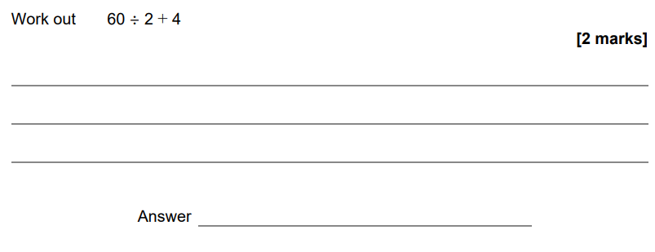
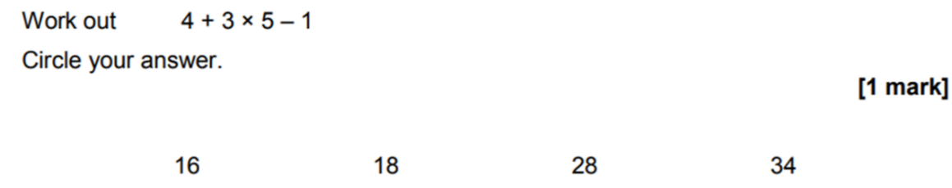
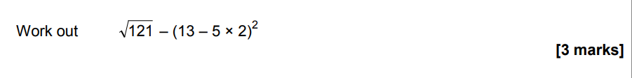
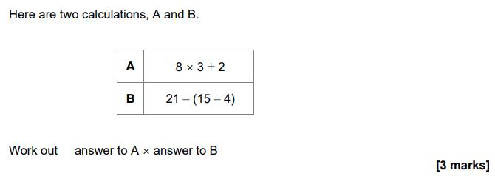
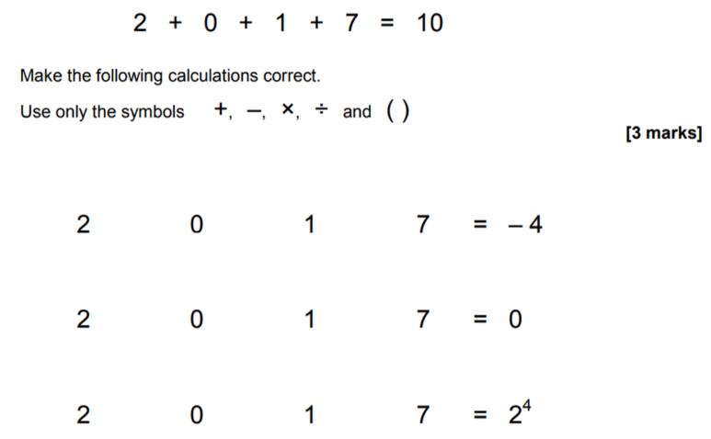
GCSE PAST PAPER QUESTIONS – Non Calculator paper
Notes:
Exam questions

